Slide 1
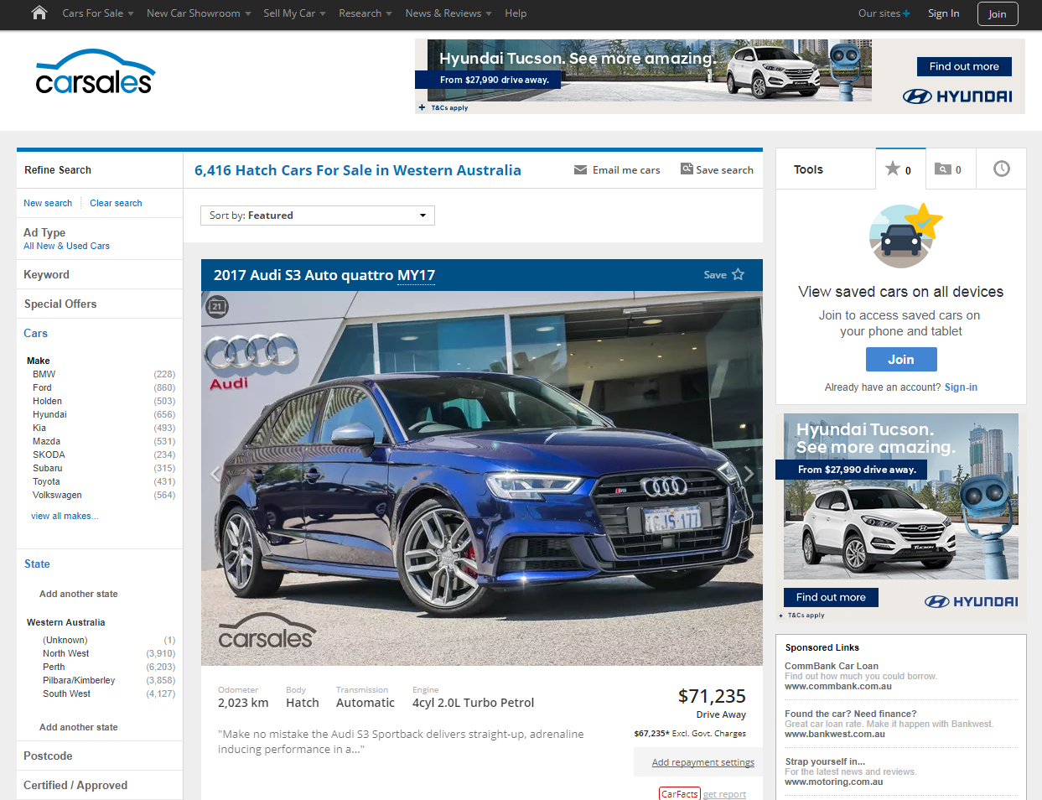

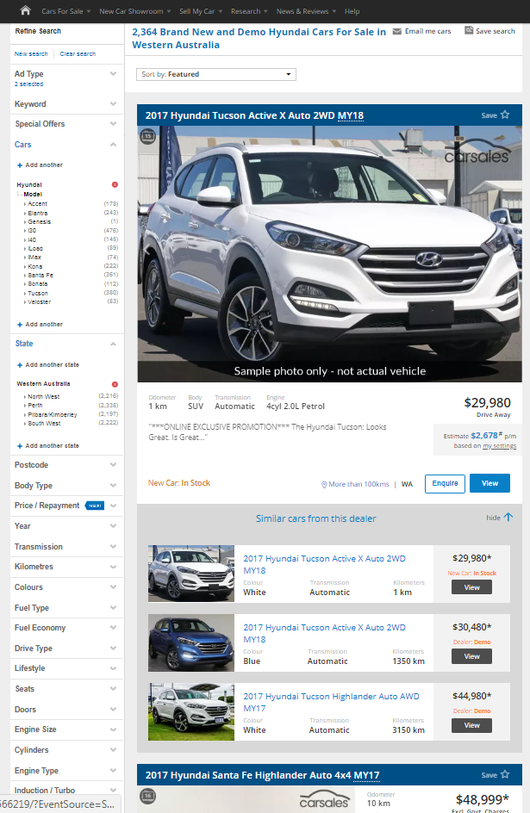


CASE STUDY:
HYUNDAI DEALER CO-OP PACKAGE
Objective
To create high reach awareness of the Hyundai model run-out sale in the WA market amongst an in-market audience
To stimulate leads, and drive inquiry through to dealers within Hyundai’s WA Dealer Co-Op
Intender reach, targeting consumers with standard display units both on and off network, with VFACTS and Geo targeting applied
Showcase listing performance tool, enabling WA Co-Op dealers to increase the awareness of relevant inventory via prominent placement within search results
Multi Listing performance tool, enabling consumers to easily preview other relevant stock items available from the franchised dealers via an expandable drop-down within search results
Solution
Results
The campaign delivered a 3.08 x increase in views per car listed by WA Co-Op dealers
During the campaign period there was a 3.35 x increase in leads per car submitted to dealers within the WA Dealer Co-Op.
Source: carsales internal data, January 2018

