Slide 1
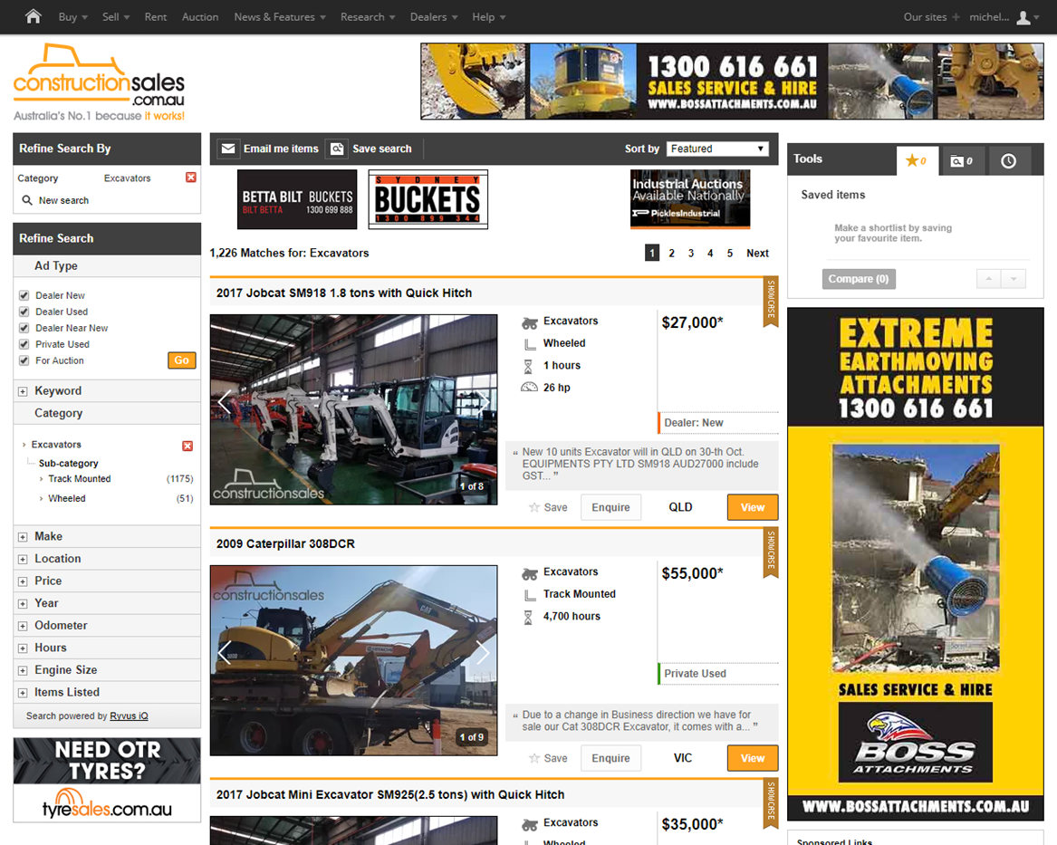

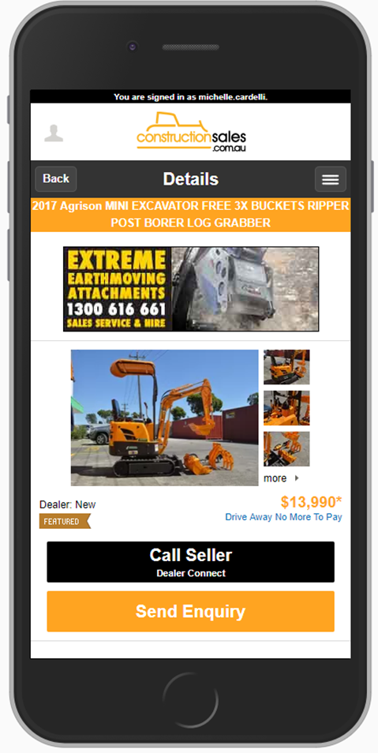
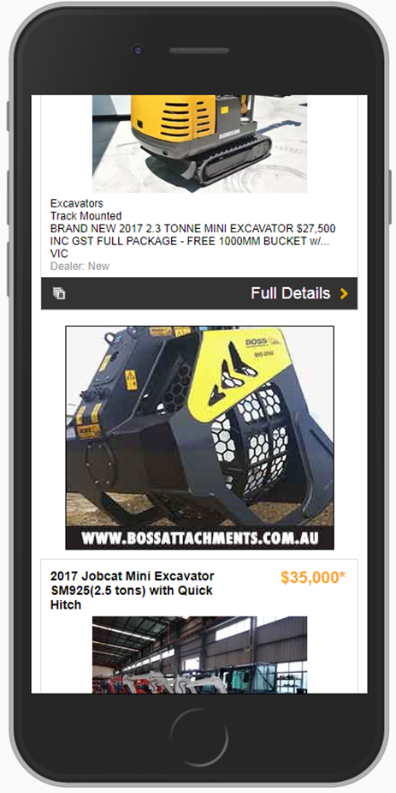


CASE STUDY:
Audience – LL&I Intender Package
Objective
To increase awareness and consideration of ‘Boss Buckets’ amongst an in-market audience close to finalising purchase.
Solution
Targeting an Intender audience (based on on-site activity) with standard display units across desktop, mobile, tablet and App.
Campaign activity both on-network through constructionsales network and off-network via Audience 360.
Results
CTR for the campaign was 5.3 x higher with Intender targeting compared to CTR results from Industry category targeting.
Source: constructionsales internal data
Notes:
In the first 4 months of 2017 Only 19% reasoned within 2 hours
We have found best practice to respond in 30 minutes – 3 other dealers – own that customer - stock locator and get them looking at other stock on your yard.
46% not followed up within 14 days

