Slide 1
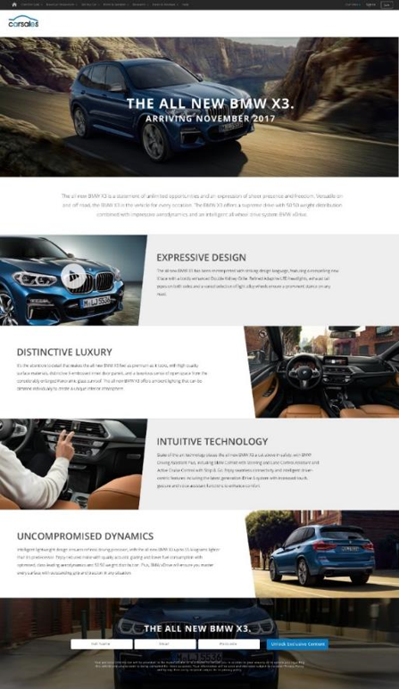





CASE STUDY:
BMW X3 PRE-REGISTRATION
Objective
To create high reach awareness for the upcoming launch of the BMW X3
To generate pre-registrations expressing interest in the BMW X3 prior to the launch
A bespoke pre-registration landing page as the destination for all media drivers, and to house the BMW X3 content.
Integrated placements driving to the pre-registration landing page including a homepage body type driver, editorial tile & membership drivers
Strong on network support through high impact, video and native integrations, as well as on and off network Intender Reach driving to pre-registration landing page
Solution
Results
45,502 unique visits to the landing page during the campaign
Users were highly engaged with 2m 45sec average time spent on the page
Pre-registrations were 104% higher than forecasted
Effective cost per pre-registration was 51% lower than forecasted
51% increase in lead share for X3 vs month prior
52% increase in view to lead conversion for X3 vs month prior
Halo effect across the BMW range with 7+% increases in view and lead share for BMW vs month prior
Source: carsales internal data, September 2017.

