Slide 1
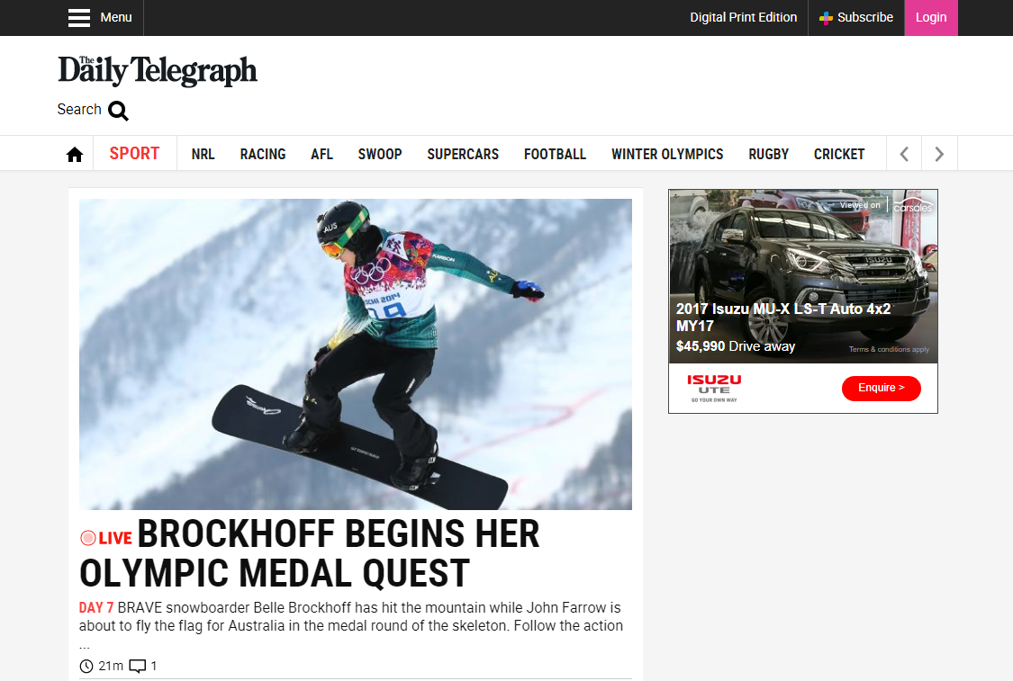

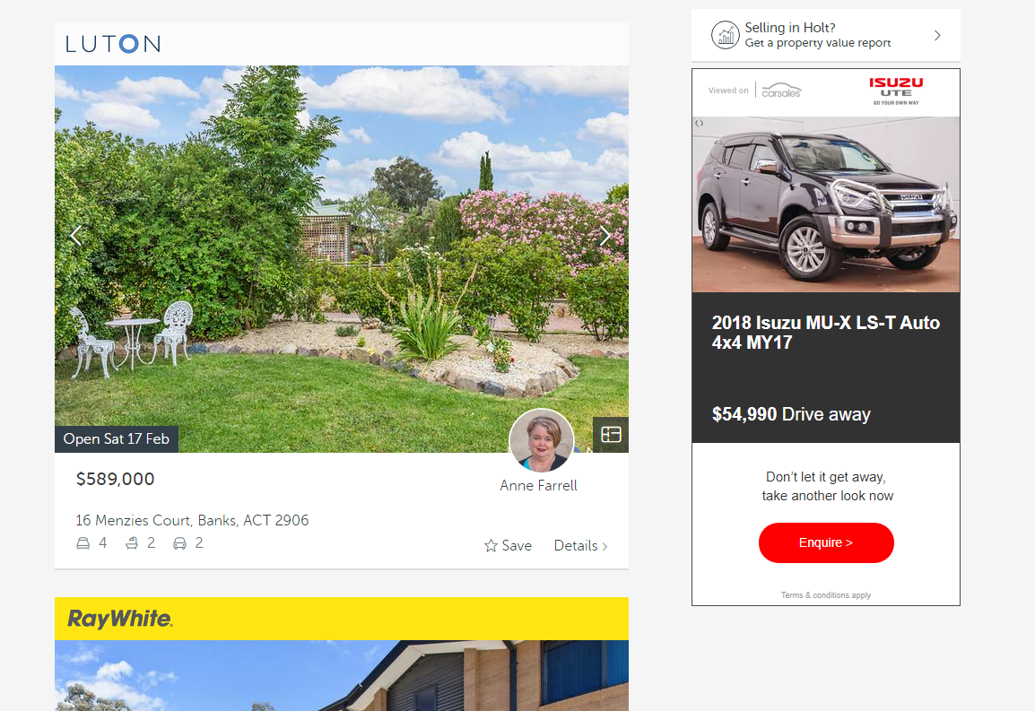


CASE STUDY:
VDP Retargeting: Isuzu MU-X
Objective
To retarget consumers who have recently viewed a new stock vehicle details page (VPD) on carsales off network, with the same vehicle, closing the loop and increasing the likelihood of generating a lead
Using carsales data, VDP Retargeting targeted an in-market audience off-network across Australia’s leading websites.
Dynamic creative executions were served based on the cars that consumers had considered when they were on the carsales network.
Solution
VDP Retargeting using carsales data ensured that Isuzu remained top of mind with the consumer during their car buying journey even when they were not on the carsales network.
The Isuzu VDP Retargeting campaign had a CTR of 0.15%; almost 2 X higher than the average CTR of 0.08%
Of those consumers who clicked, 73% went on to submit a lead on the vehicle displayed in the VDP campaign.
Results
Source: internal data webtrends

