Slide 1
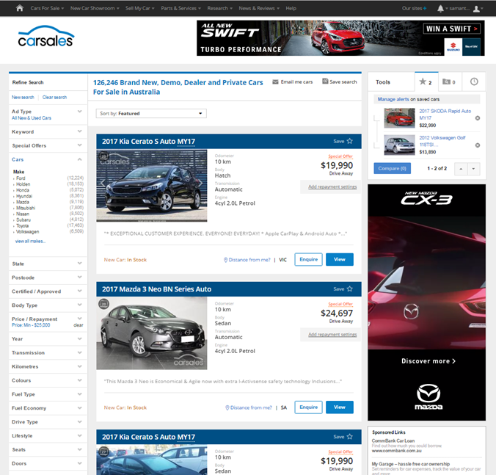

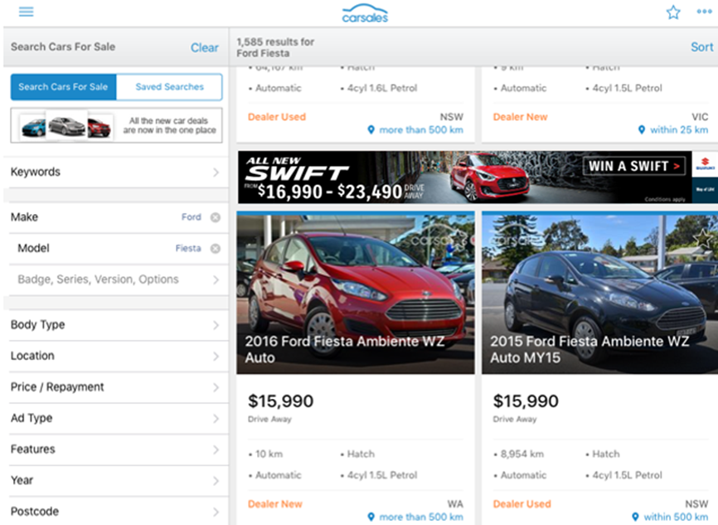

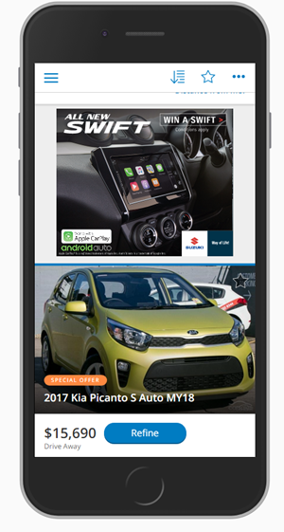

INTENDER REACH:
Audience – Intender Reach
Objective
To increase awareness and consideration of the Suzuki Swift amongst an in-market audience for light/small passenger car.
Solution
Target an Intender audience (based on on-site activity) with standard display units across desktop, mobile, tablet and App.
Activity both on-network through the carsales auto network, and off-network via Audience360.
Results
72% uplift in Swift’s share of searches for light/small passenger car.
33% uplift in Swift’s share of ‘detailed page views’ for near new light/ small car
Source: carsales internal data

