Slide 1


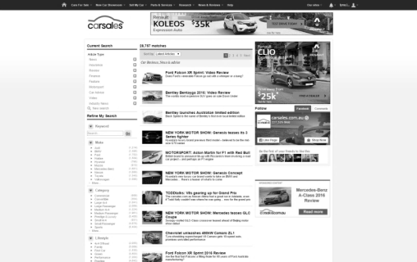
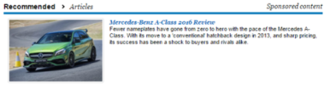

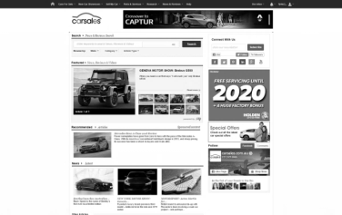

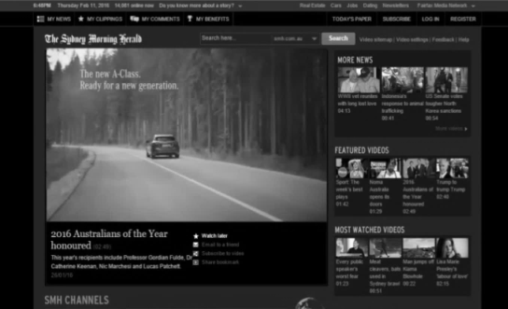


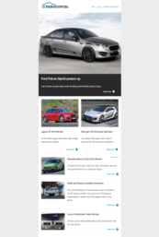
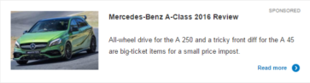

CONTENT AMP
Engaging content is a powerful way to get your car into the consumer’s consideration set.
Content Amp increases the longevity of your carsales editorial or brand produced content, and ensures that your relevant content is still highly visible and readily available to consumers whenever they enter the market to build their consideration set.
Content Amp is promoted to an in-market audience on the carsales network, off network through our data partnership with Audience 360, through social media, and via our email newsletters, and drives consumers to an environment where they can engage with your content.
Results have shown to drive a significant increase in editorial visits, with Beta partners seeing up to 3.5 X boost in organic views, and a positive flow on effect on model searches. Consumers spent over 2 minutes engaging with the content.

