Slide 1
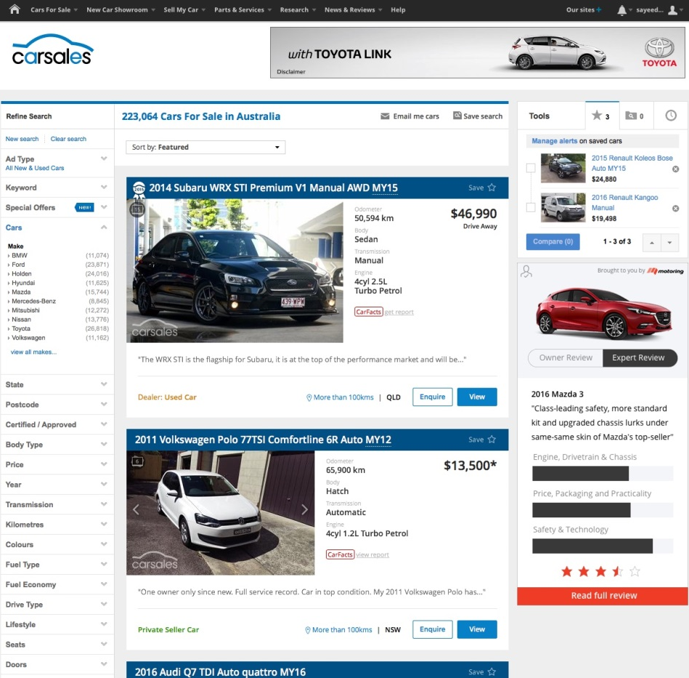

RATINGS AMP
Car reviews and ratings are a highly trusted source of information for car buyers when they are in the landscape and consideration phases of their new car research.
Ratings Amp is a native ad placement that boosts the reach of car model reviews and ratings within the carsales in-market buying marketplace, and off-network, retargeted to matching intenders, through our data partnership with Audience360.
Advertisers can choose to amplify an independent expert review that Motoring.com.au have written about a key model, or they can boost the reach of a carsales’ owner review.
Ratings Amp is opening up for beta partners in 2017.

