Slide 1
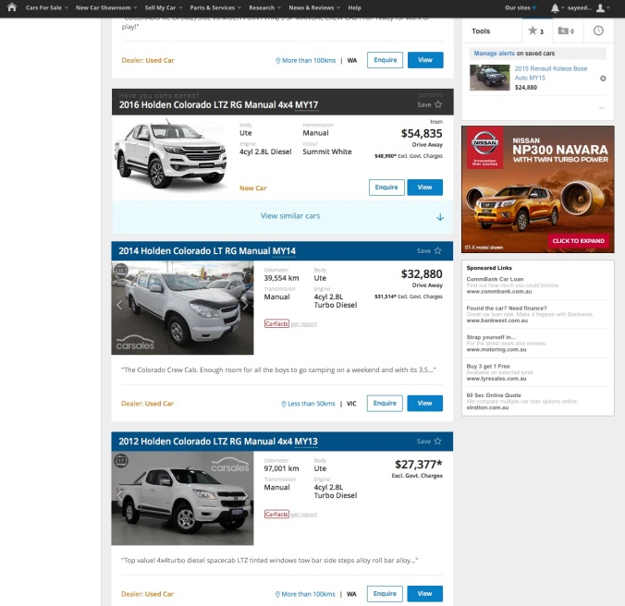
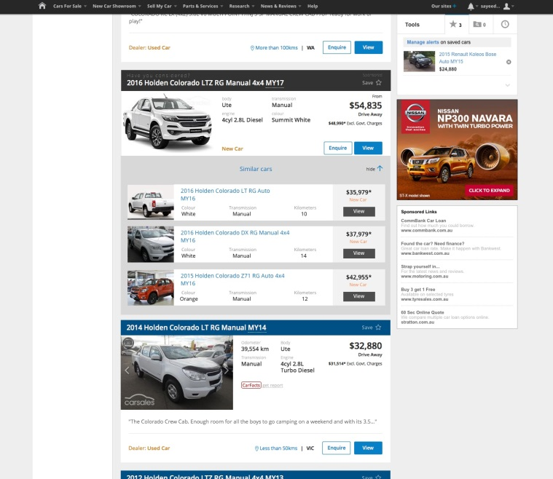
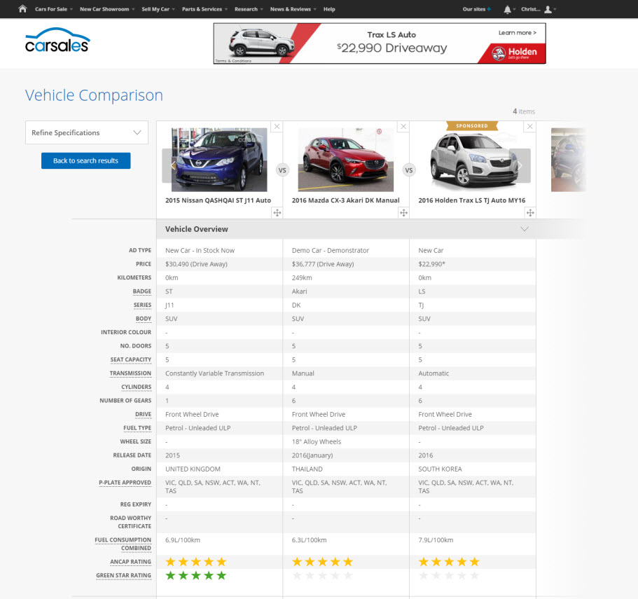

CONSIDERATION
PACKAGE
The consideration package encompasses two native ad placements, both designed to get your car model on the buyer's consideration list.
Guaranteed Consideration, which promotes a manufacturer’s generic new car listing by seeding it amongst search results for new and used competitive models, and captures the attention of consumers researching vehicles in your VFACTS competitive set, who may not have considered that vehicle previously.
The Comparison Tool, which allows consumers to directly compare price and specs of cars side-by-side, with a native ad unit automatically placed in view. The Comparison Tool is being relaunched across multiple areas of the network, including carsales stock search, new car showroom, and Redbook.

