Slide 1
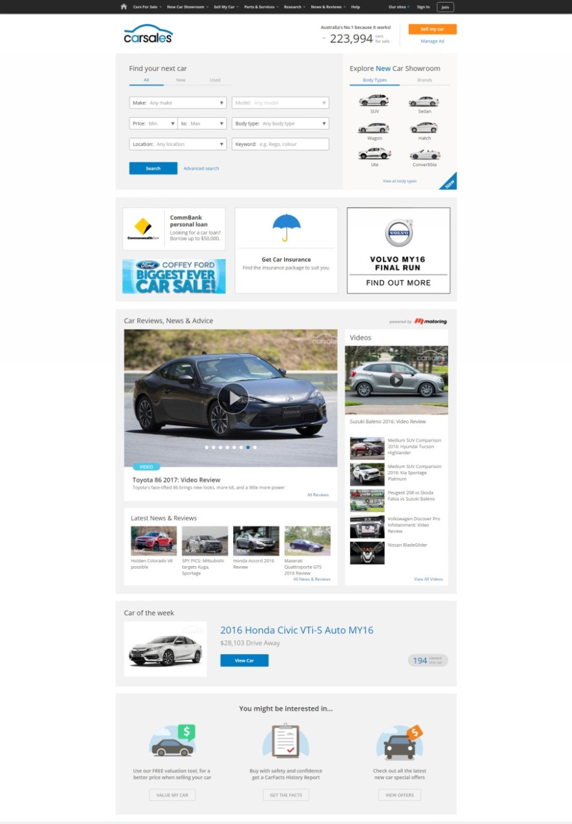

CAR OF THE WEEK &
CAR OF THE WEEK PLUS
Car of the Week is a popular native sponsorship placement, delivering high reach awareness for a single model in a brand family for a whole week.
The Car of the Week placement appears in various prominent positions across the carsales auto network, targeting consumers as they research the market, and form their consideration set.
Car of the Week is currently displayed across desktop, mobile and tablet, with additional exposure coming through the carsales apps in 2017.
An upsized option - Car of the Week Plus – will be available in the product mix in 2017, with additional exposure amplified across membership, editorial and results feeds.

