Slide 1
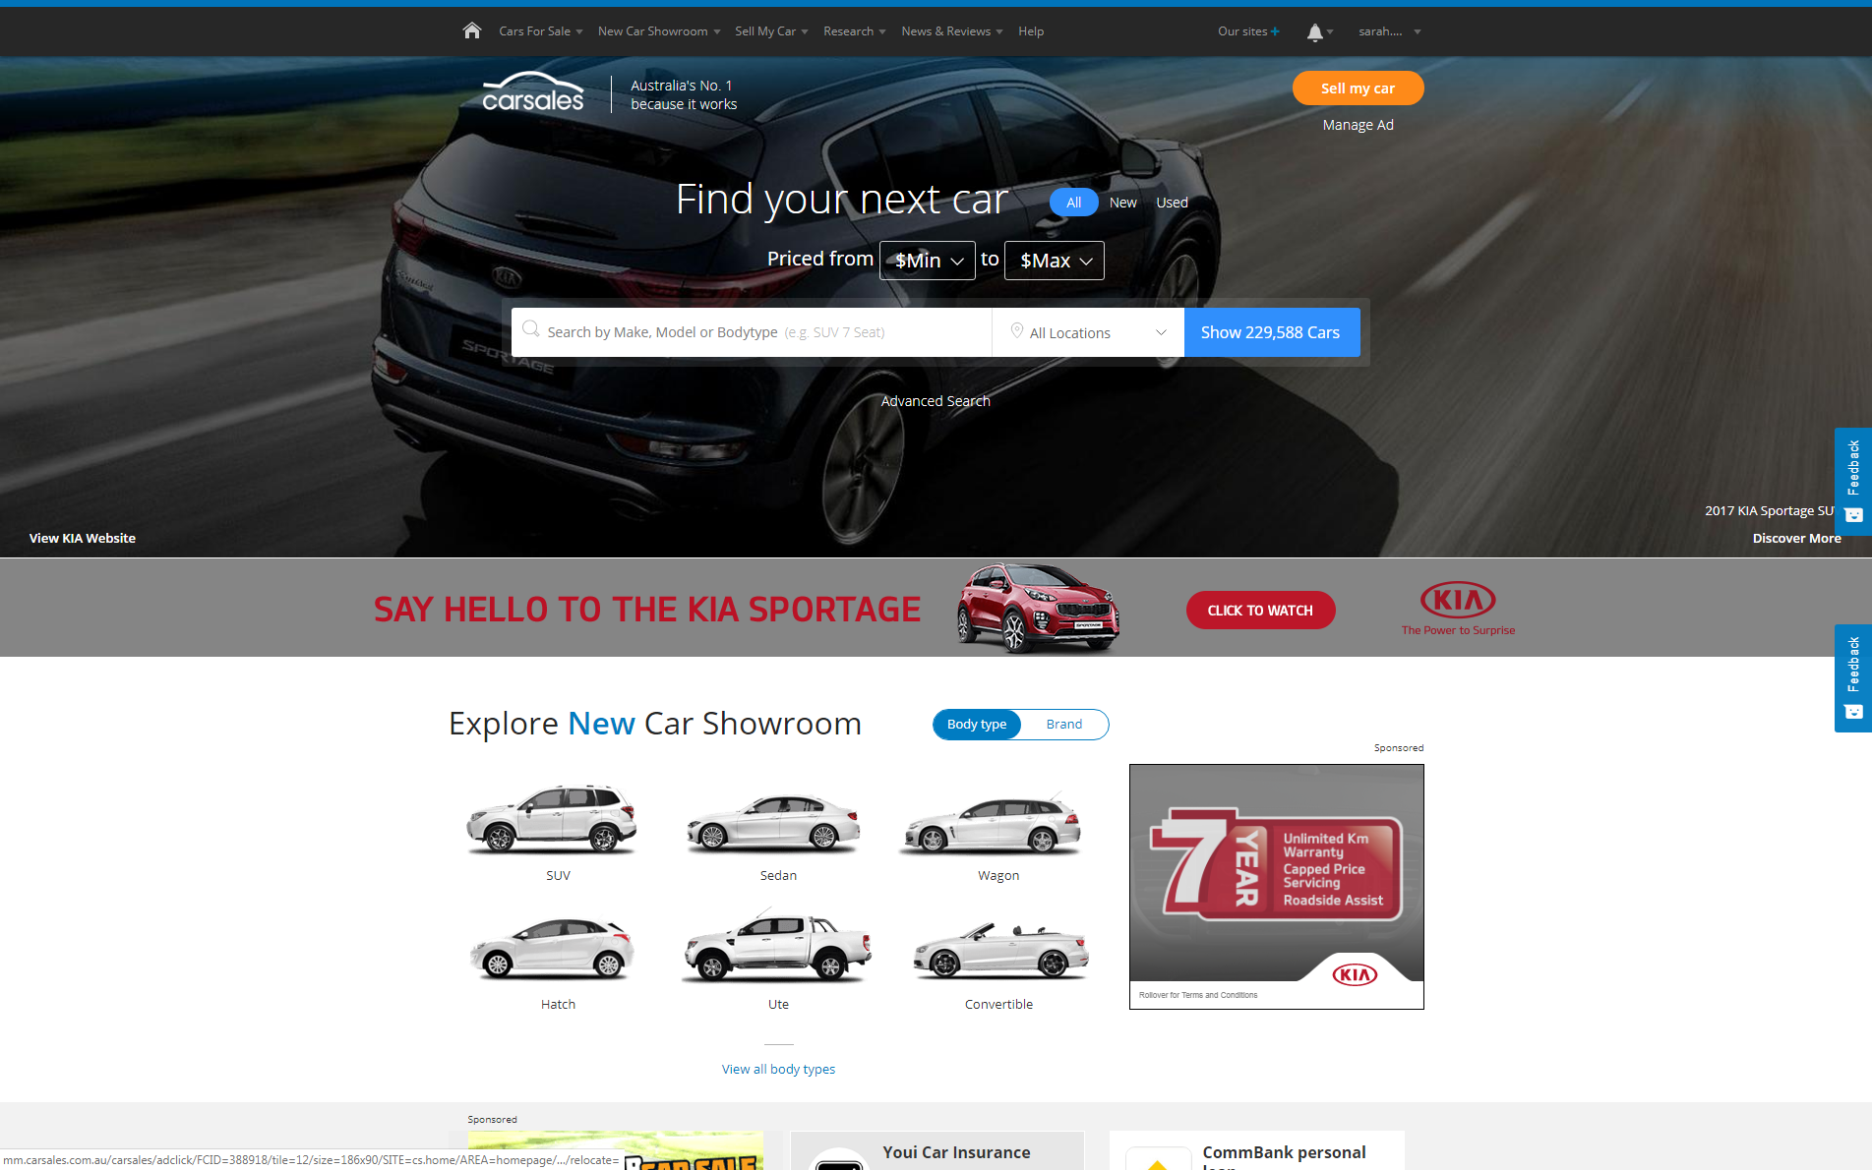


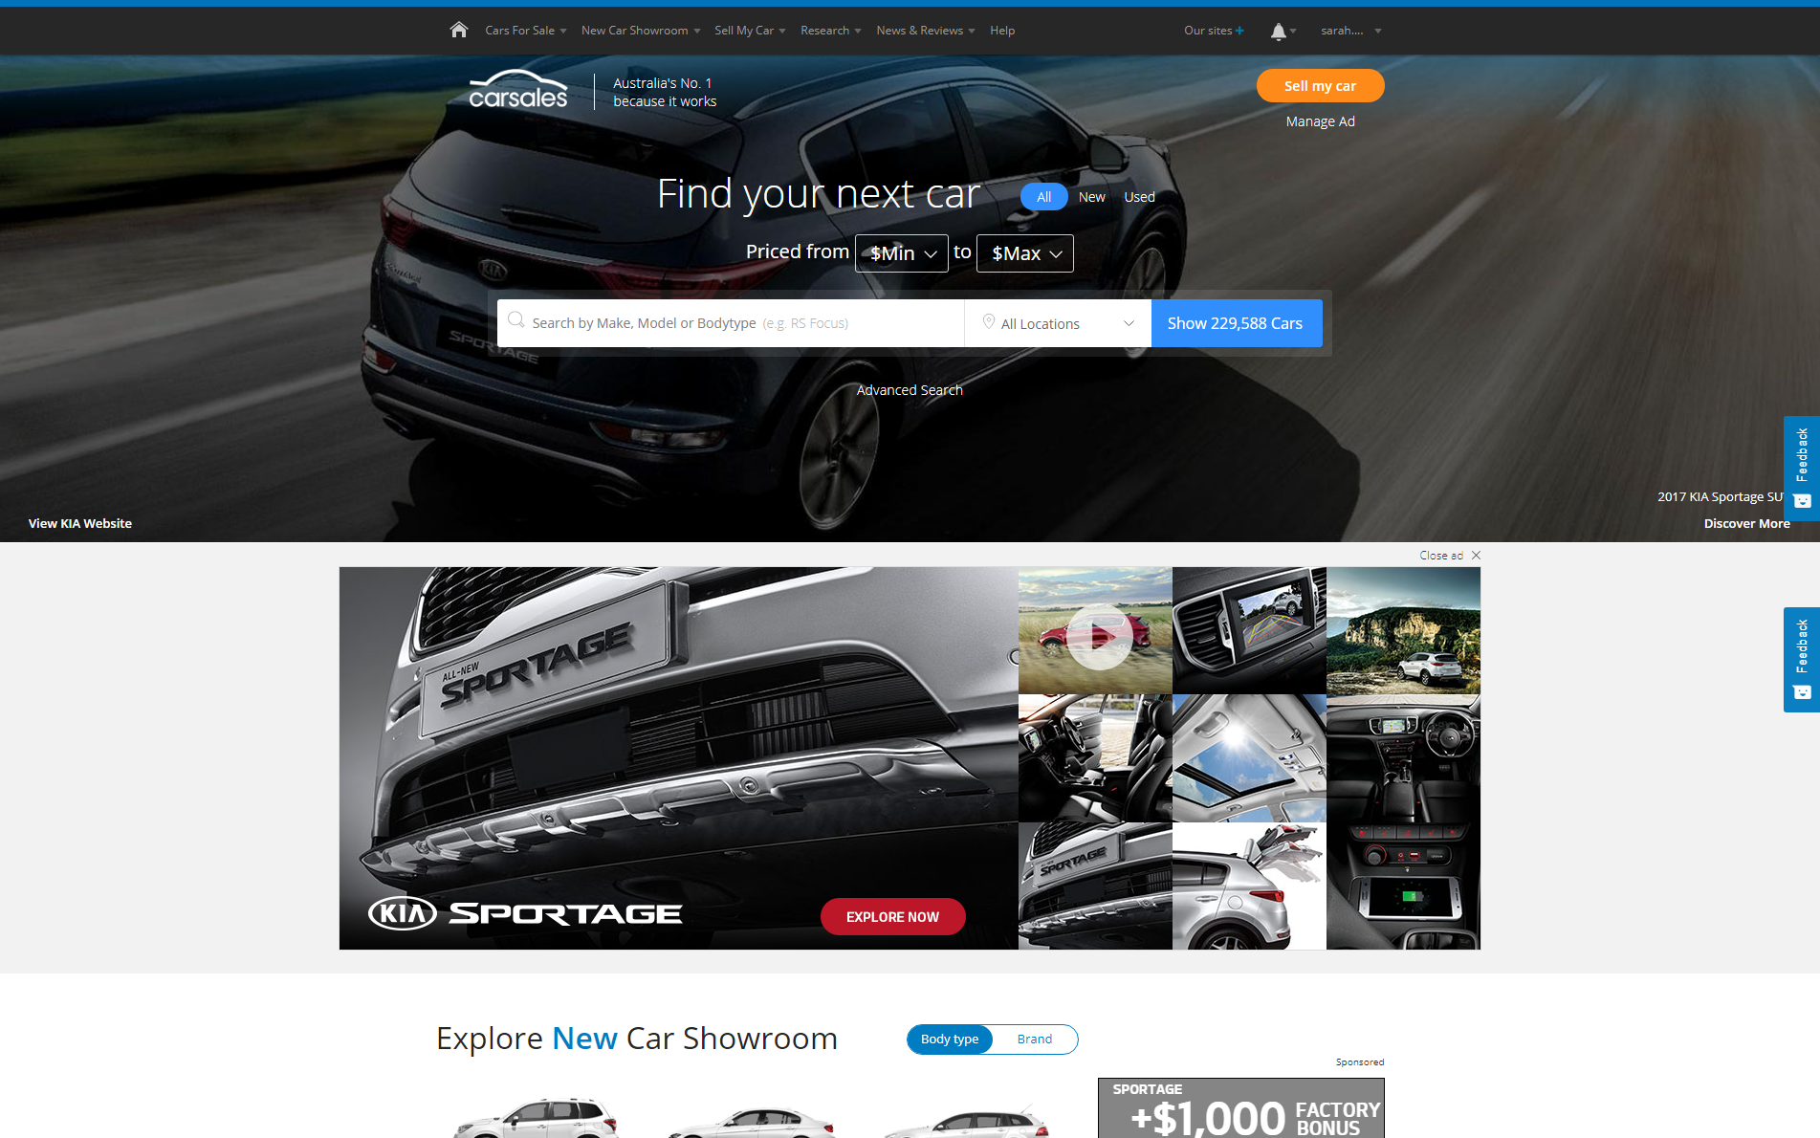

CASE STUDY:
HIGH IMPACT 2017 - UPDATED
Objective
Increase consumer engagement through a native approach
Create high reach awareness for brands looking to connect with a relevant and engaged audience
Solution
High Impact – new Homepage Buyout format on carsales
Ownership of the hero image, interactive strip ad & MREC
First 3 impacts across the network
Results
Model view share increased by up to 53% 2 days post buyout for exposed users
Brand view share increased up to 19% 2 days post buyout for exposed users
Brand halo effect with consumers 20% more likely to view a new car within the week post exposure
Increased competitive consideration of up to 52% vs day prior
Influenced consumers immediate post exposure action with an increase of 17% in brand searches from the homepage
4x increase in model traffic to new car showroom on the buyout date
Source: carsales internal data 2017

