Slide 1
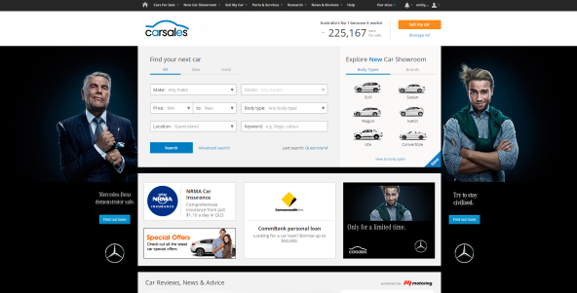

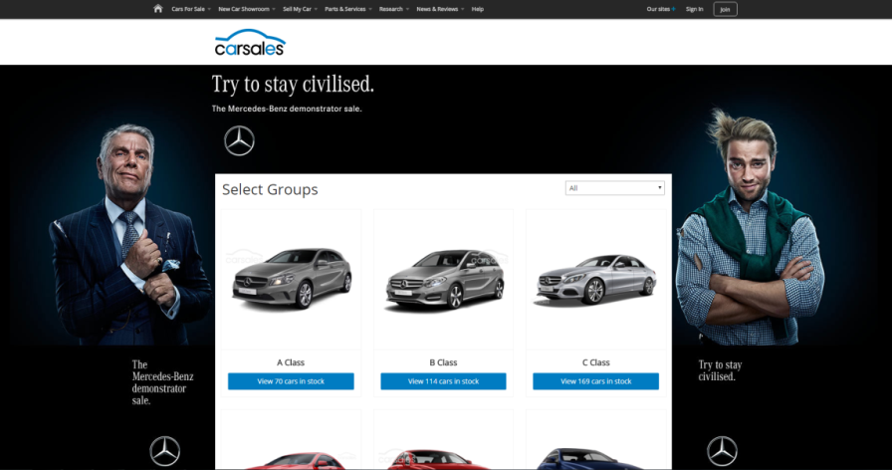

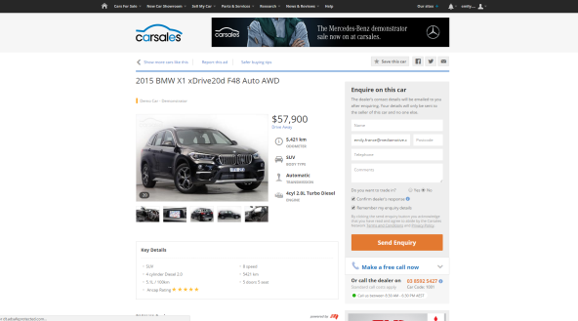
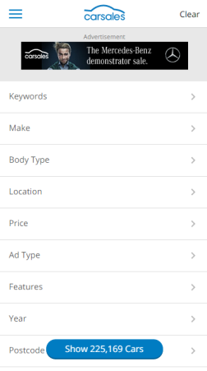

MERCEDES-BENZ
DEMONSTRATOR SALE
Objective
To generate awareness of the Mercedes-Benz Demonstrator sale
Drive enquiry to dealers for demo stock, with a goal of clearing the available demonstrators
A Hub providing an online platform for Mercedes-Benz dealers to list demonstrator vehicle stock during clearance sale
High Impact placements, Consideration Packages, and Intender Audience Reach
Banners and sponsorships driving traffic through to Mercedes-Benz Demonstrator Clearance Hub
Solution
Results
56% increase in view share for Mercedes-Benz Demonstrators during the campaign period
34% increase in lead share for Mercedes-Benz Demonstrators during the campaign period
48% increase in demo lead volume post campaign vs pre campaign
Halo effect across new cars, with a 30% increase in New Car lead share post campaign vs pre-campaign
Source: carsales internal data, webtrends

