Slide 1
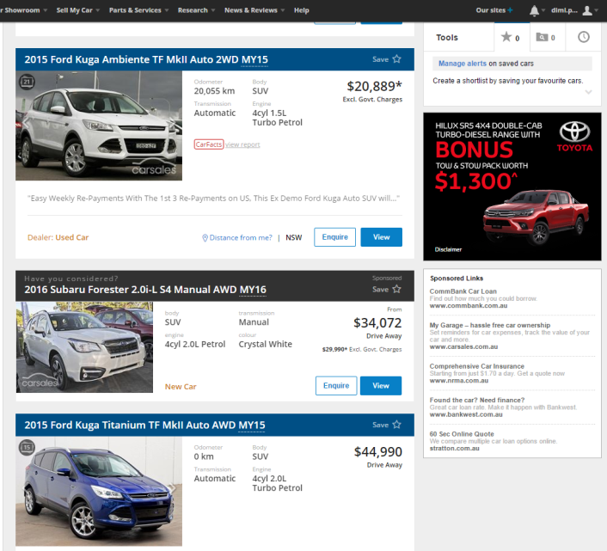


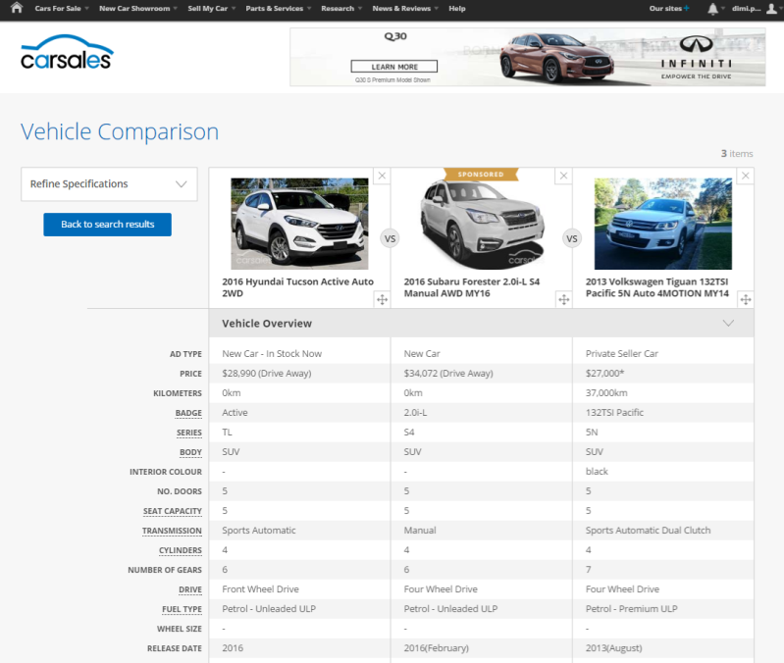

CASE STUDY:
CONSIDERATION PACKAGE
Objective
To generate awareness for key models within the Subaru range, and get them in to the consideration set with in-market consumers.
Consideration Packages for each model encompassing two native ad placements, designed to get Subaru on the buyer's consideration list;
Guaranteed Consideration - which promotes a generic new car listing by seeding it amongst search results for competitive models and
The Comparison Tool - which allows consumers to compare prices and specs of cars side-by-side, with a native ad unit automatically placed in view.
Solution
Results
All Consideration Packages produced a significant increase in consideration (view share) for models within their respective categories vs PCP;
Impreza 184% increase in view share
Levorg 179% increase in view share
Outback 126% increase in view share
Forester 117% increase in view share
Source: webtrends. Increase is WoW

