Slide 1

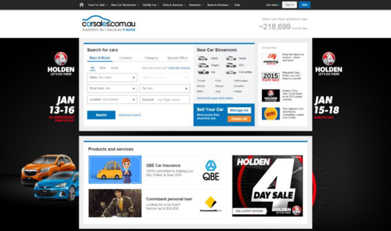
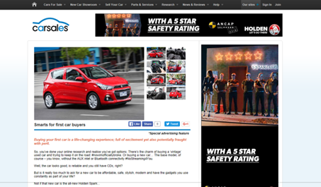


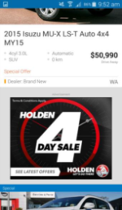
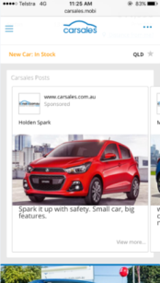

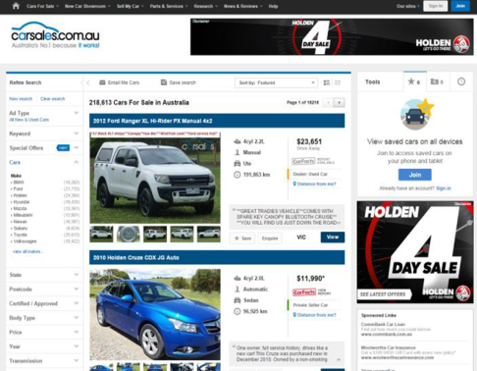

CASE STUDY:
HOLDEN 4 DAY SALE
Objective
To create high reach awareness of the Holden 4-Day Sale amongst an ‘in market’ audience
Solution
High Impact – Homepage Buyout
Results
View share increased by 19% WOW
Lead share increased by 53% WOW
Drove 5,060 in market buyers through to OEM website
Source: internal data webtrends, January 2016

