Slide 1
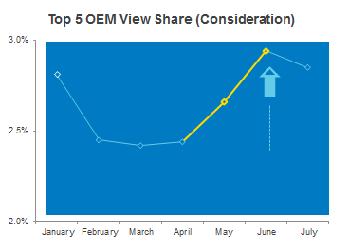


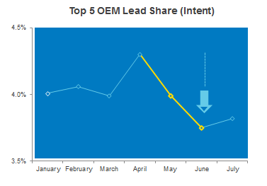

CASE STUDY:
BRAND TERMS BUYOUT
Objective
To maintain 100% share of mind when consumers are searching for your new car brand on carsales, ‘Brand Terms’ buyout ensures that only your messaging is displayed on your search results.
The Test
A Top 5 OEM shifted their strategy from continuity (Brand Terms buyout) to conquesting their competitors by increasing activity further up the funnel, with high impact, awareness products.
Results
High impact awareness products saw their view share increase by 20.5%, showing an upward shift in consideration
However, by relinquishing their Brand Terms this OEM was no longer closing the loop for users looking at their cars, which led to a 12.8% decrease in lead share (intent)
Source: carsales internal data, webtrends

