Slide 1
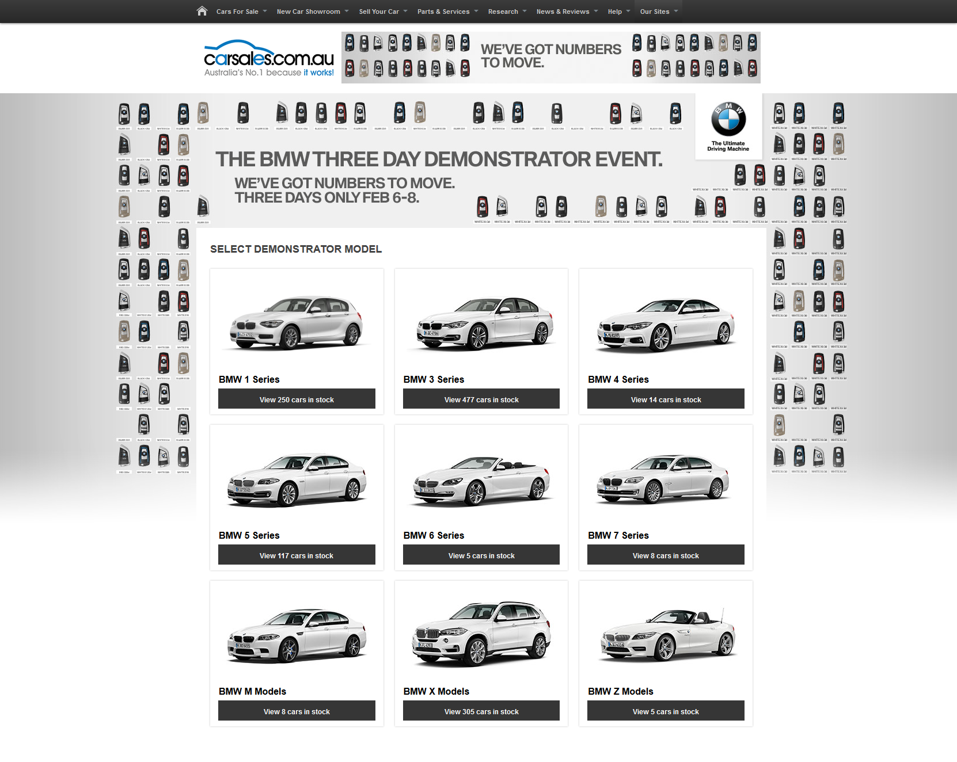



CASE STUDY:
BMW DEMONSTRATOR SALE
Objective
To generate awareness of the sale event
Drive enquiry to BMW dealers for demo stock, with a goal of clearing the demonstrators available
Solution
A sense of site ownership with high frequency of Homepages on all devices, as well as 1st impact activity to further drive frequency
Modifications to the HUB, as well as a custom built demo page to ensure the full range of vehicles were presented in the best possible light to drive conversion
Results
28% increase in views of BMW Demos
49% increase in demo leads, with a halo effect across new cars
43% increase in new car leads
80% increase in stock removed from carsales, indicating cars sold
BMW jumped to the top cross enquired vehicle across its key competitors
Source: carsales internal data, webtrends

