Slide 1
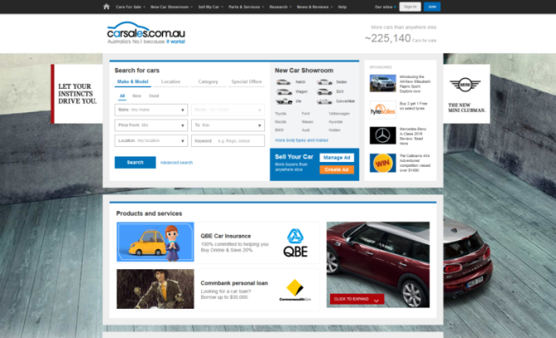
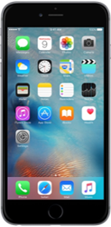
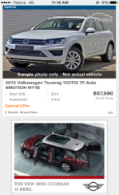
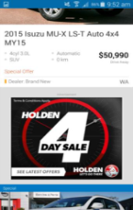
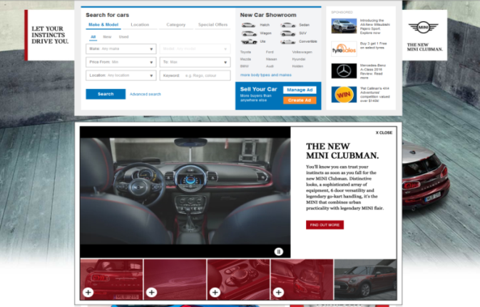
CASE STUDY:
MINI CLUBMAN – LAUNCH
Objective
To create high reach awareness of the new Mini Clubman to an ‘in market’ audience
Solution
High Impact – Homepage buyout
Results
View share increased by 27% WOW
Lead share increased by 34% WOW
Drove 8,804 qualified in market buyers through to OEM website
Source: internal data webtrends, February 2016

