Slide 1


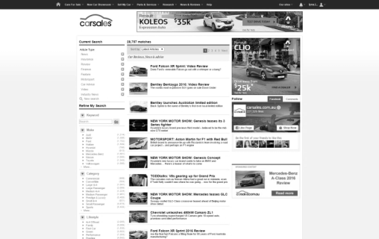

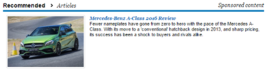
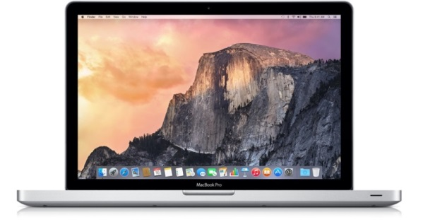
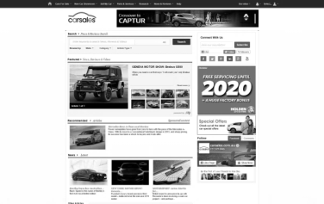


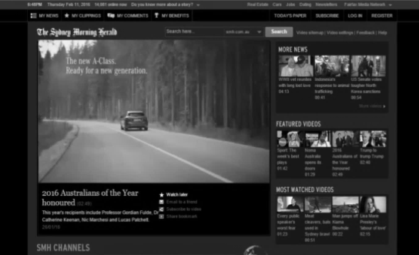
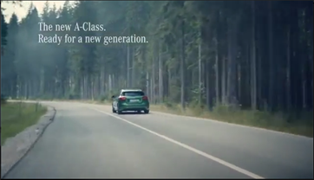


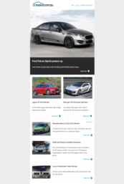
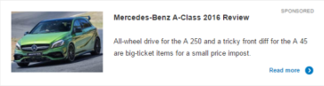
CASE STUDY:
CONTENT AMP
Objective
To generate & maintain awareness of the new A-Class facelift to a relevant, in-market audience
Increase brand consideration of the Mercedes-Benz A-Class
Solution
Distribute and amplify influential carsales editorial through Content Amplification to targeted and engaged audience across multiple devices both On and Off Network, through Social, and via the carsales eDM
Results
100% increase in article views during the Content Amplification campaign period compared to the PCP
2 minutes, 12 seconds average time spent engaging with the article
6.1x higher engagement (CTR) on the Native drivers versus standard display banners

