Slide 1
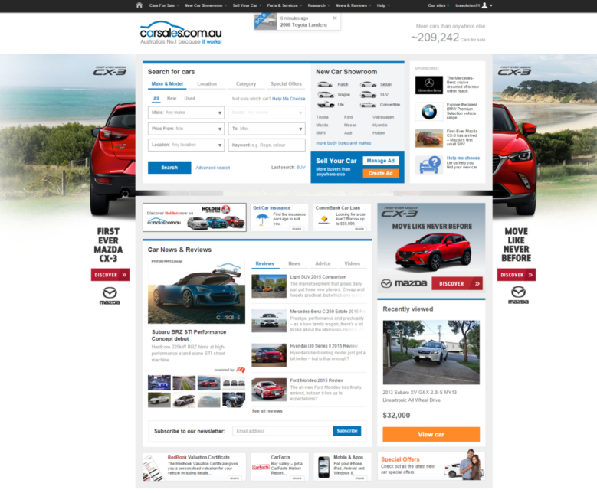



CASE STUDY:
MAZDA CX-3 – LAUNCH
Objective
To generate high reach awareness of the new Mazda CX-3
Increase consideration and intent for the CX-3 in the competitive SUV category
Solution
High impact placements to influence consumers at the top of the funnel – Homepage Buyout
Guaranteed Consideration package to promote Mazda CX-3 amongst competitive make/model search result pages across all devices.
Results
In month 2, the CX-3 achieved 21.52% of view share, the highest of the entire category and more than double their closest competitor highlighting how successful high impact placements are in driving consideration with buyers as they enter the market
109% increase in view share when compared to PCP
46% increase in lead share when compared to PCP
Source: carsales internal data, webtrends

