Slide 1
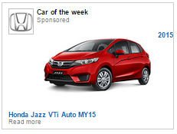


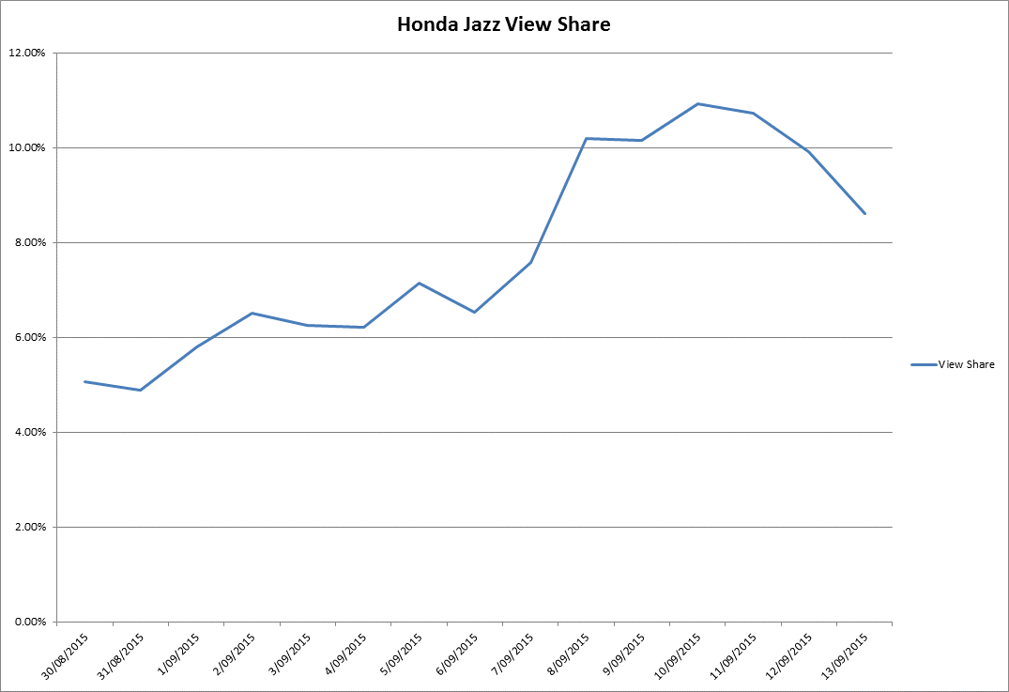

CASE STUDY:
CAR OF THE WEEK - NATIVE
Objective
To increase consideration of the Honda Jazz amongst an in market audience.
Solution
Promote the Honda Jazz using Native Content – through our ‘Car of the Week’ product
Results
The Car of the Week promotion drove a big increase in consideration for the Honda Jazz, as well as across the Honda range.
There was 163% increase in views for Honda Jazz in the week that the campaign ran.
The campaign had a halo effect across the brand, with a 57% increase in views for Honda models across the site.
Source: carsales internal data, webtrends 2015

