Slide 1

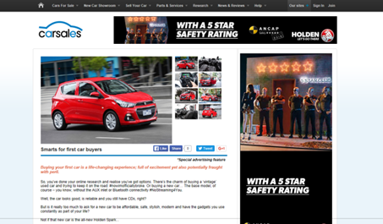



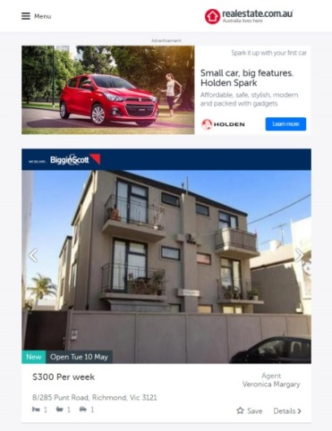


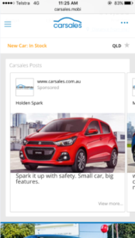
CASE STUDY:
HOLDEN SPARK CONTENT AMP
Objective
To communicate the launch of the new Holden Spark to relevant Influencer and Intender audience segments
Drive rapid awareness of the new Holden Spark, as well as to effectively position the Spark as the vehicle of choice for both First Car buyers as well as their parents
Solution
To engage First Car buyers (Intenders) and their parents (Influencers) by amplifying lifestyle based content On Network, Off Network, across Social and through eDMs
Results
15,897 content views, driven by Native Ads within both premium editorial and classified environments
1 minute, 24 seconds average time spent engaging with the Holden Spark branded content piece
40% increase in views of video content during the campaign period compared to pre-campaign
3.3x higher engagement (CTR) on the Native drivers versus standard display banners
Source: webtrends April/May, 2016

